Slide 1
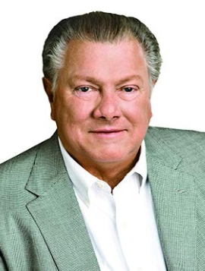
ALBERTSONS COMPANIES
BOB MILLER
Chairman and CEO

Slide 2
JOE ALBERTSON’S PHILOSOPHY

